Slide 1
Online Shopper’s purchasing Intention
By:
Shubhdeep Singh
Shaunak Phaldessai

Slide 2
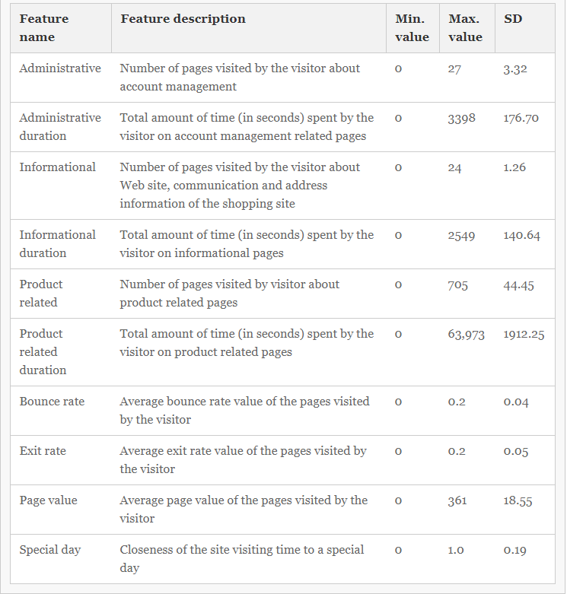
About Dataset
The dataset contains records of online session information belonging to 12330 different users.
Every record in the dataset belongs to the session of a different user over a period of 1 year.
There are 10 numerical and 8 categorical attributes.
The data includes the number of page visits by a particular user to administrative pages, informational content and product related page visits and the duration of stay.
The data also includes bounce rates, exit rates and page value attributes of each user that are part of the google analytics.
The bounce rate of a page refers to the percentage of users who enter the site through that page and then leave without triggering any requests on that page.
The page value is the average value of a page that a user visited before buying something.

Slide 3
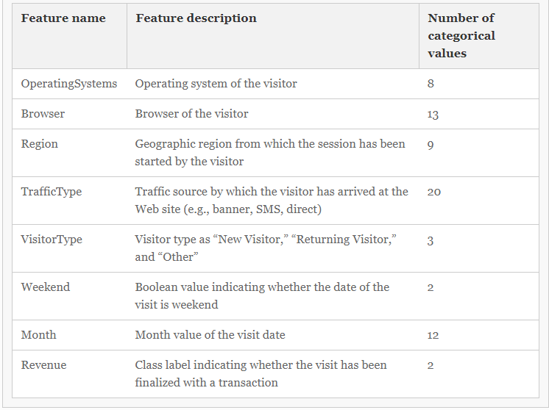
Goal
We try to determine whether a particular user of a website will convert or not. i.e. if a user is going to buy something from an e-commerce website or not.
The decision is based on user actually buying a product from a website.
Hypothesis
A user spending more time exploring the e-commerce website and having a less bounce rate is more likely to convert or buy from a website.

Slide 4
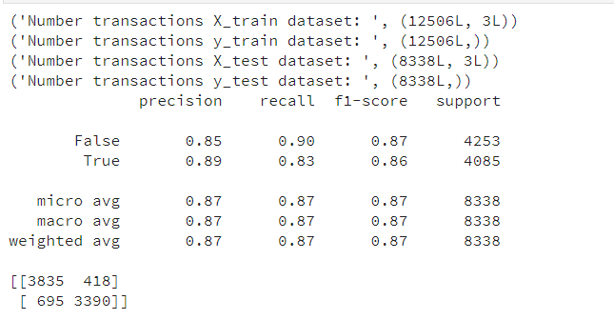
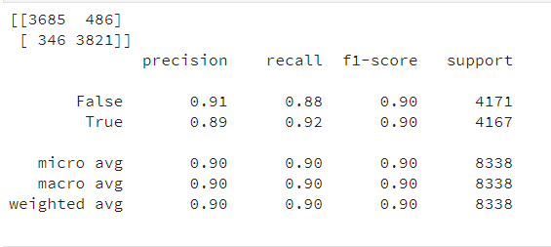
Results
K-Neighbours classifier
Decision tree
The decision tree classifier with all the features and a 60-40 split of the data gave a classification error rate of 0.092.
The K neighbours classifier with tuned parameters p=1 and weights=‘distance’ gave a classification error rate = 0.133
The decision tree classifier is better than the k-neighbours classifier since it uses all the features of the dataset and provides better precision and f1- score along with lesser classification error rate.

